Slide 1
TERMS AND CONDITIONS
These PowerPoint slides are a tool for lecturers, and as such:
YOU MAY add content to the slides, delete content from the slides, print out the slides, and save the slides onto your computer or server.
YOU MAY NOT resell, reproduce or redistribute the content in any form whatsoever, without prior written permission from the copyright holder.
© Troupant Publishers (Pty) Ltd, 2016
Selected images used under licence from Shutterstock.com

Slide 2
Engineering Systems
NQF Level 2

Slide 3
Equipment with simple control systems
Topic 2

Slide 4
Identifying equipment with simple control systems
Module 11

Slide 5
Equipment with simple control systems
Unit 11.1

Slide 6
Defining a control system
Figure 11.1 Process to be controlled

Slide 7
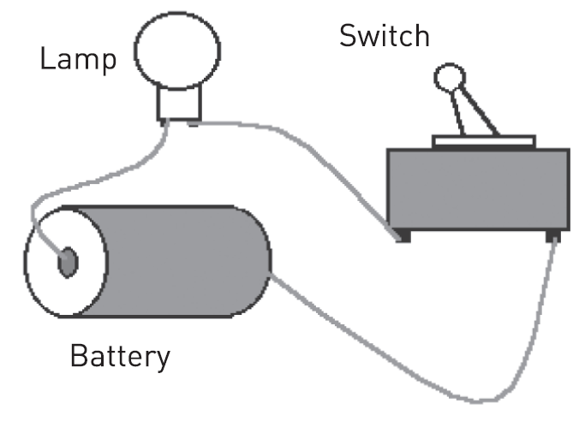
Defining a control system
Figure 11.2 A basic circuit with a lamp

Slide 8
Defining a control system
Figure 11.3 Circuit diagram of a lamp controlled by a switch

Slide 9
Terms used in control systems
Process.
Controller.
Input.
Output.

Slide 10
Terms used in control systems
Figure 11.4 A block diagram of a simple control system

Slide 11
Components of control systems
Transducers.
Actuators.
Sensors.
Relays.

Slide 12
Components of control systems
Transducers
A device that converts one type of energy to another.
Can be to or from electrical, electro-mechanical, electromagnetic or any other form of energy.

Slide 13
Components of control systems
Transducers
Figure 11.5 A thermocouple

Slide 14
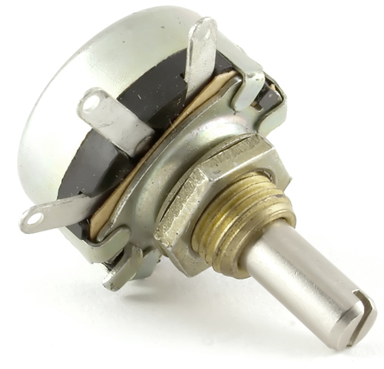
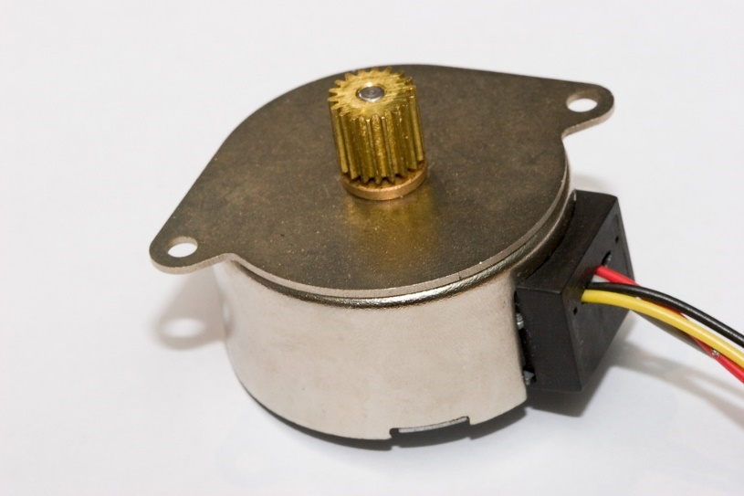
Components of control systems
Transducers
Figure 11.6 A rotary potentiometer
Figure 11.7 A stepper motor

Slide 15
Components of control systems
Actuators
A mechanical device that moves or controls a mechanism or system.
Examples are:
Electrical motors.
Pneumatic actuators.
Hydraulic pistons.
Relays.

Slide 16
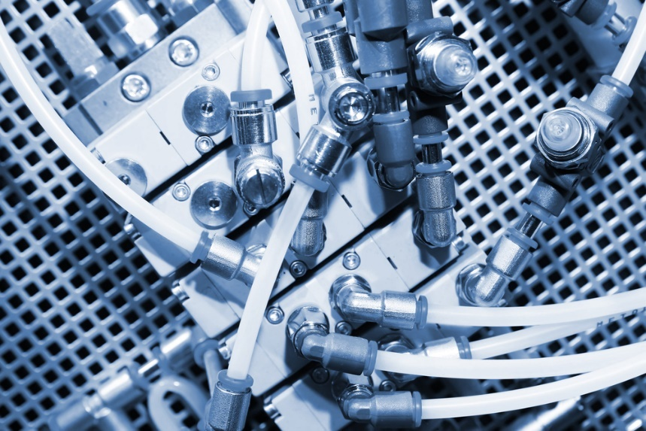
Components of control systems
Actuators
Figure 11.8 An electrical motor
Figure 11.9 A pneumatic actuator

Slide 17
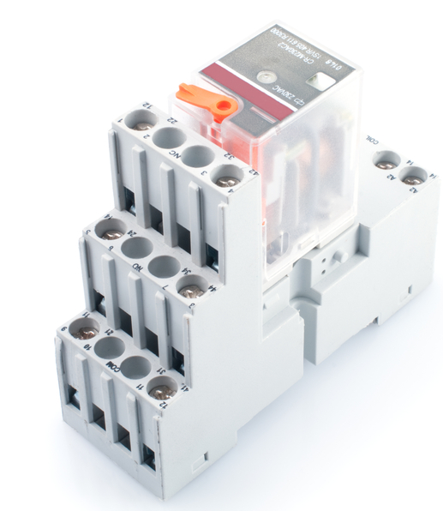
Components of control systems
Actuators
Figure 11.10 A hydraulic piston
Figure 11.11 A relay

Slide 18
Components of control systems
Sensors
A device that measures a physical quantity and converts it into a signal that can be read by an observer or an instrument.
Examples are:
Mercury thermometer.
Thermocouple.

Slide 19
Components of control systems
Table 11.3 Examples of sensors
Physical quantity | Type of sensor
Angular position | Resistive rotary position sensor
Angular velocity | Tachogenerator
Flow | Flow sensor
Linear position | Linear variable differential transformer (LVDT)
Light level | Photocell Light-dependent resistor (LDR) Photo diode Photo transistor
Liquid level | Float level switch
Proximity | Reed switch
Temperature | Thermocouple and Thermistor

Slide 20
Components of control systems
Sensors
Figure 11.13 A light-dependent resistor (LDR)

Slide 21
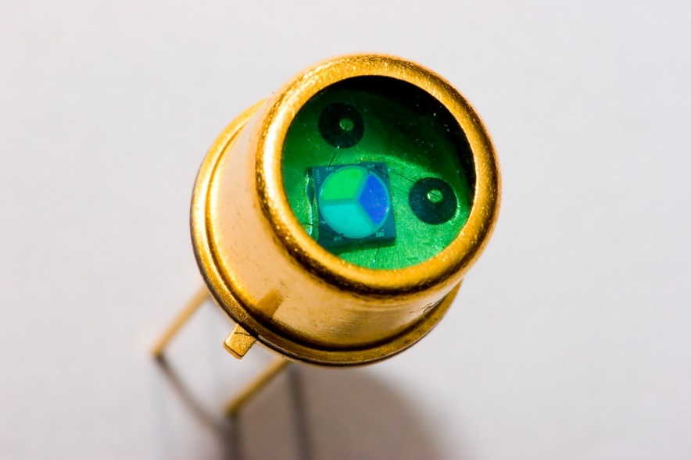
Components of control systems
Sensors
Figure 11.14 A photo diode

Slide 22
Components of control systems
Sensors
Figure 11.15 A float level switch

Slide 23
Components of control systems
Sensors
Figure 11.16 A reed switch

Slide 24
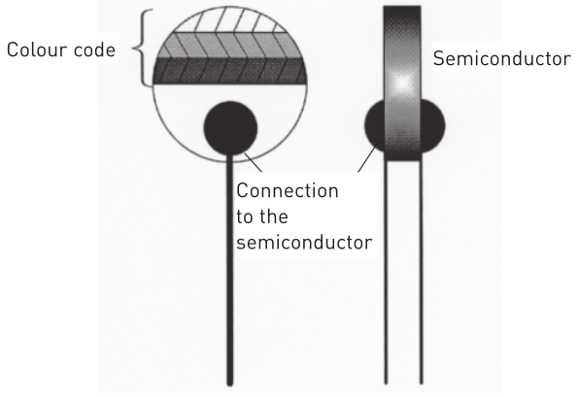
Components of control systems
Sensors
Figure 11.17 A thermistor

Slide 25
Components of control systems
Relays
Figure 11.18 Relays used in the automation industry

Slide 26
Functions of a control system
The four main functions:
Measurement.
Comparison.
Computation.
Correction.

Slide 27
Applications of control systems
To regulate the speed of an electric motor.
To regulate the speed or position of a linear actuator in robotics.
To monitor the temperature of a furnace.
To monitor the pressure of a vessel, for example a steam boiler.
To monitor the flow of liquids or gases, for example the steam flow to a turbine.
To start or stop machines.
To detect errors in the system and sound an early-warning signal.

Slide 28
Applications of control systems
Figure 11.19 A robotic arm

Slide 29
Open- and closed-loop systems
Open-loop systems
A system in which the output is dependent on the input.

Slide 30
Open- and closed-loop systems
Open-loop systems
Figure 11.20 An open-loop system

Slide 31
Advantages and disadvantages of an open-loop system
Advantages and disadvantages of an open-loop system
Advantages | Disadvantages
They are simple in construction. | The system is inaccurate and unreliable.
They are convenient when output is difficult to measure. | A change in the external environment will produce inaccurate results.
They are easy to maintain. | The controller needs to be recalibrated regularly.

Slide 32
Examples of open-loop systems
Traffic lights.
An automatic door.
This circuit:
Figure 11.3 Circuit diagram of a lamp controlled by a switch

Slide 33
Open- and closed-loop systems
Closed-loop systems
A system in which the controlling action or input is dependent on the output. Such a system uses feedback.

Slide 34
Open- and closed-loop systems
Closed-loop systems
Figure 11.21 A closed-loop system

Slide 35
Advantages and disadvantages of a closed-loop system
Advantages and disadvantages of a closed-loop system
Advantages | Disadvantages
It is extremely accurate. | It is a complex system.
It adjusts automatically to environmental changes. | Due to feedback, the system may cause oscillation.

Slide 36
Examples of closed-loop systems
Figure 11.22 An electric oven

Slide 37
Examples of closed-loop systems
Figure 11.23 The cruise control of a car

Slide 38
Multivariable control systems
Most of the time a system does not control only one signal at a time, but many signals.
As a system becomes more complex, the interrelationship of many controlled variables must be considered.

Slide 39
Multivariable control systems
Figure 11.24 A multivariable control system

Slide 40
Computer control systems
Computer control systems are used to improve the use of energy and minimise waste emissions.
Used to coordinate the control of >100 variables in a large factory.

Slide 41
Computer control systems
Figure 11.25 A computer control system

Slide 42
Programmable logic controllers (PLCs)
A PLC is a computer used for the automation of electromechanical processes.
For example, control of machinery in factory assembly lines.

Slide 43
Programmable logic controllers (PLCs)
Figure 11.26 A programmable logic controller (PLC)

Slide 44
Components of a PLC
The five basic components:
Central processing unit (CPU) or processor unit.
Programming device.
Memory unit.
Input and output devices.
Power supply.

Slide 45
Components of a PLC
Figure 11.27 Block diagram of a PLC

Slide 46
Components of a PLC
Input devices:
Switches (mechanical or magnetic).
Photoelectric sensors.
Encoders.
Temperature sensors.
Strain gauges.
Pressure sensors.
Keypads.
Limit switches.

Slide 47
Components of a PLC
Input devices:
Figure 11.28 Input devices

Slide 48
Components of a PLC
Output devices:
Figure 11.29 Output devices

Slide 49
Pneumatic control circuits
The signal flow is from the energy source to the power section (the final control system and the actuator.
The final control element receives control signals from the signal processor.
The signal processor processes information sent from the input devices or sensors.

Slide 50
Pneumatic control circuits
Figure 11.30 Circuit diagram of a pneumatic control circuit

Slide 51
Pneumatic control circuits
Figure 11.31 A sequence circuit (cylinders extend in succession)

Slide 52
Hydraulic control circuits
Open-loop hydraulic system – hydraulic fluid is returned into a large, unpressurised tank at the end of the cycle.
Closed-loop hydraulic circuit – hydraulic fluid stays in one closed pressurised loop without returning to the main tank after each cycle.

Slide 53
Hydraulic control circuits
Figure 11.32 An open-loop hydraulic circuit

Slide 54
Hydraulic control circuits
Figure 11.33 A closed-loop hydraulic circuit

Slide 55
Hydraulic valves
Usually heavy duty to withstand high pressure.
Some can control direction of flow of fluid and act as a control unit for a system.

Slide 56
Hydraulic valves
Classification of valves based on function:
Pressure control valves.
Flow control valves.
Direction control valves.

Slide 57
VIDEO: Relief valve

Slide 58
Hydraulic valves
Classification of valves based on method of activation:
Directly operated valves.
Pilot operated valves.
Manually operated valves.
Electrically actuated valves.
Open control valves.

Slide 59
Gauges
Gauges are used as measuring instruments.
Information from the gauges is fed back into the control system, or can be monitored by the user, or both.

Slide 60
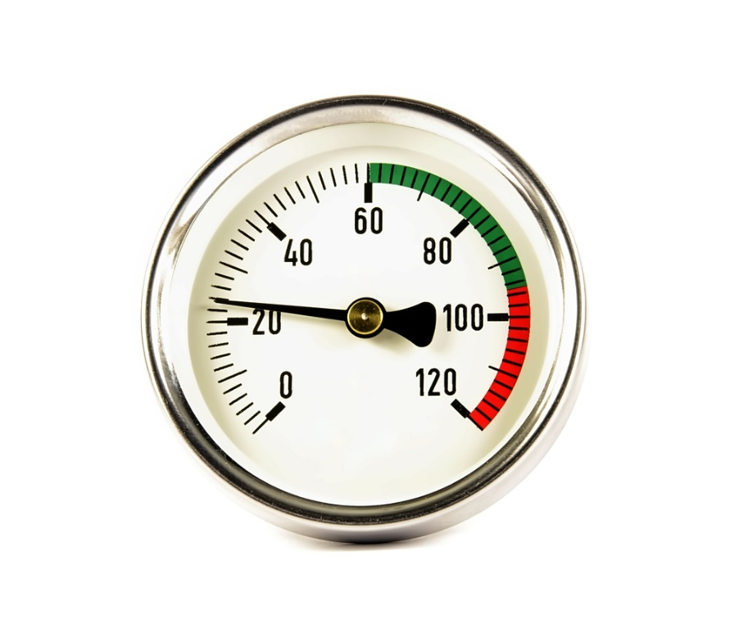
Gauges
Figure 11.34 A pressure gauge
Figure 11.35 A temperature gauge

Slide 61
VIDEO: Relief settings

Slide 62
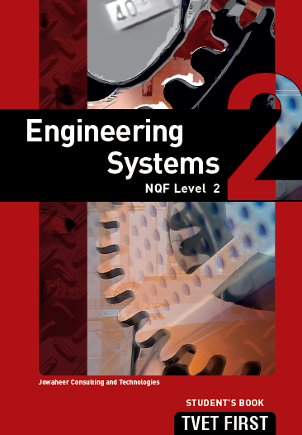
Summative assessment
Test your knowledge of this section by completing the Summative assessment (page 187 of your Student’s Book)

